Slide 1
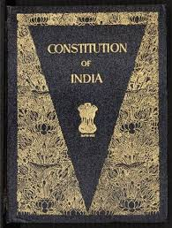


Salient Features of the Indian Constitution
By Kangkana Sharma, Assistant Professor, Dhing College.

Slide 2
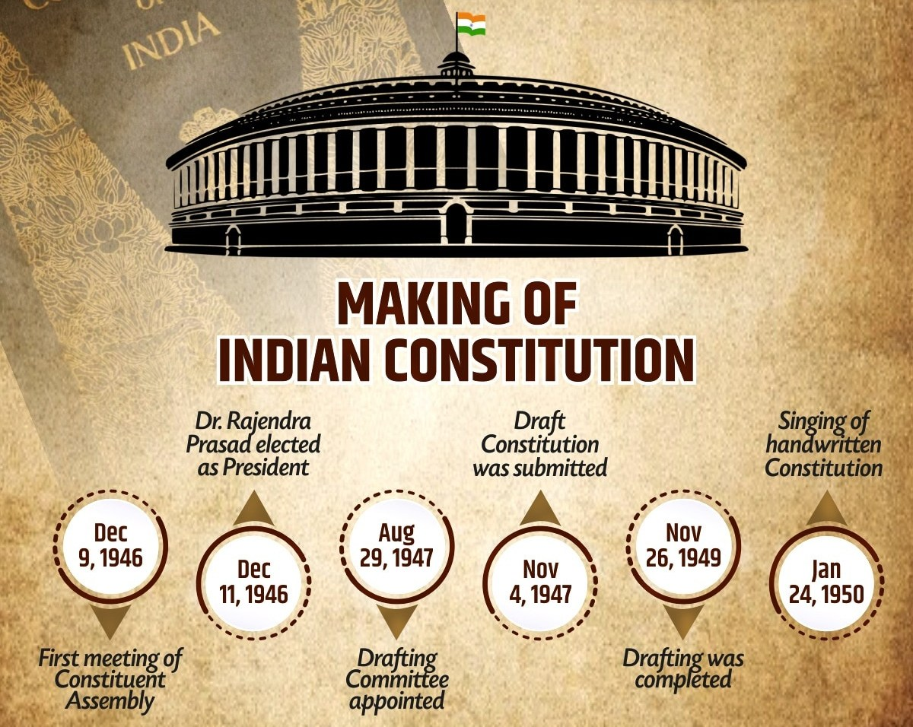


Slide 3
Sources of the indian constitution
Govt. of India Act, 1935 (Federal Structure, Judiciary etc.)
US Constitution: Fundamental Rights, Judicial Review
Australian Constiution: Concurrent List, German Constitution: Emergency Provisions
Irish Constitution: DPSP, Canadian Consitution: Federation
British Constitution: Rule of Law, Parliamentary Govt.

Slide 4
Features of the Indian constitution
1. The Lengthiest Constitution in the World.-
The Constitution of India is the lengthiest of all the written Constitutions of the world. It is a very comprehensive, elaborate and detailed document.
The Indian Constitution originally consisted of 395 articles divided into 22 Parts and 9 Schedules. Presently, it consists of a Preamble, has 470 articles divided into 25 Parts and 12 Schedules (as of May, 2025).

Slide 5
Salient Features of Ind. Constitution:
2. Parliamentary Form of Government.-
The Constitution of India has opted for the British Parliamentary system of Government rather than American Presidential System of Government. The Parliamentary system is based on the principle of co-operation and co-ordination between the legislative and executive organs while the Presidential system is based on the doctrine of separation of powers between the two organs.

Slide 6
Salient Features of Ind. Constitution:
3. Unique Blend of Rigidity and Flexibility.-
The Constitution of India is neither rigid nor flexible but a synthesis of both. A rigid Constitution is one that requires a special procedure for its amendment while flexible Constitution is one that can be amended in the same manner as ordinary laws are made.

Slide 7
Salient Features of Ind. Constitution:
4. Fundamental Rights.-
Part III of the Indian Constitution guarantees six fundamental rights to all the citizens—
(a) Right to Equality (Articles 14-18);
(b) Right to Freedom (Articles 19-22);
(c) Right against Exploitation (Articles 23-24);
(d) Right to Freedom of Religion (Articles 25-28);
(e) Cultural and Educational Rights (Articles 29-30);
(f) Right to Constitutional Remedies (Article 32).

Slide 8
Salient Features of Ind. Constitution:
5. Directive Principles of State policy.-
The Directive Principles of State Policy contained in Part IV of the Constitution set out the aims and objectives to be taken by the state in the governance of the country. According to B.R. Ambedkar “the Directive Principle of State policy is a novel feature of the Indian Constitution. They can be classified into three broad categories, Socialistic, Gandhian and Liberal-intellectual.

Slide 9
Salient Features of ind. Constitution:
6. Fundamental Duties.-
By Forty-second Amendment Act, Part IVA has been added to the Constitution which enumerates certain fundamental duties of the citizens. Originally, ten duties were enlisted in clause (a) to (j) of article 51A. Clause (k), which imposes duty on parents/wards has been added by the Constitution (86th Amendment) Act, 2002.

Slide 10
Salient Features of ind. Constitution:
7. A Federation with Strong Centralizing Tendency.-
The term ‘federation’ has nowhere been used in the Constitution. Article 1 describes that India “is a Union of States” which implies two things: Firstly – Indian federation is not the result of an agreement by the States; and Secondly – no State has the right to secede from the federation. The Constitution of India establishes a federal system of Government. It contains all the usual features of a federation viz., two governments, division of powers, written Constitution, Supremacy of the Constitution, rigidity of Constitution, independent judiciary and bicameralism.

Slide 11
Salient Features of ind. Constitution:
8. Adult Suffrage.-
In India every person, male or female, who has obtained the age of 18 years, is entitled to vote in elections to Parliament or State Legislatures. Originally this age limit was 21 years but after the 61st Amendment Act, 1988 it was reduced to 18 years.

Slide 12
Salient Features of ind. Constitution:
9. An Independent Judiciary.-
Independence of Judiciary is essential for impartial adjudication of disputes between individuals, between Union and State, between Union/State and individuals, between Union and States or between States inter se. The Supreme Court stands at the top of the integrated judicial system in the country. Below it, there are High Courts at the State level. This single system of courts enforces both the Central laws as well as the States laws.
The Supreme Court of India is a federal court, the highest court of appeal, the guarantor of the fundamental rights of the citizens and the guardian of the Constitution

Slide 13
Salient Features of ind. Constitution:
10. A Secular State.-
The Constitution of India stands for a secular State. Hence, it does not uphold any particular religion as the official religion of the Indian State. The term ‘Secular’ was added to the Preamble of the Indian Constitution by the 42nd Amendment Act, 1976. Articles 25-28 of the Constitution give concrete shape to this concept of secularism.

Slide 14
Salient Features of ind. Constitution:
11. Single Citizenship.-
In most of the federation, people have double citizenship, citizenship of the Union and citizenship of one of the several States which form the Union. Every citizen is the citizen of India and enjoys the same rights of citizenship no matter in which State he resides.

Slide 15
Salient Features of ind. Constitution:
12. Separation of Powers.-
This doctrine was for the first time properly formulated by the famous Jurist Montesquieu in his Escript Des Lois and exercised great influence on the French legal system. Doctrine of separation of powers implies that powers of the three organs of the government viz., Legislative, Executive and Judiciary should be kept separate from each other.

Slide 16
Conclusion
The Indian Constitution is a flexible and inclusive framework balancing federalism, rights, and governance in a diverse society.
However, its centralising bias, complex structure and frequent amendments attract critical scrutiny.

Slide 17
Thank you

